Slide 1

Information Encoding Standards Final Project Part 2
Mukesh Kumar(200467460)

Slide 2
Project Summary
As part of the final project working as a consultant for Security Technologies Recommendations company and will solve some business question.

Slide 3
About You
A IT MBA professional from University of Pune & Bachelor in computer science from University of Mumbai, I have consulting experience of 4+ years. I have proven ability to analyze client requirements and suggest the best possible solutions for critical problems in the system. I have the expertise in implementation & maintenance of Enterprise & Mid-level applications across complex environments for clients across the globe.
My core skills: - Requirements Gathering - Functional Architecture Design - Stakeholder Management - Design & Test Documentation - Product Implementation & Support - Project Management - Service Management - Business Process Modelling - Change Management - Release Management - Proposal Development

Slide 4
Questions and Recommendations
How can we transfer personal data securely within their network?
The best method to transfer personal file with a network is FTP(File Transfer Protocol). FTP is a client-server protocol that uses two channels of communication and ensure security by password protection. A client can upload, download, remove, rename, transfer, and copy files to and from a server using FTP .

Slide 5
Business Question 2
What security protocol is best for transferring personal files?
The best Security protocol for transferring personal data is HTTPS(Hypertext Transfer Protocol Secure).
Hypertext transfer protocol secure (HTTPS) is the secure version of HTTP
HTTPS uses an encryption protocol to encrypt communications, which is called Transport layer security

Slide 6
Business Question 3
Can we encode and encrypt images?
Yes, we can encode and encrypt images.
It can be done in the same way we encrypt plain text. If we encrypt the value of RGB / position we will be able to achieve image encryption.
Moreover, there are Image encryption algorithms based on balanced pixel and Chaotic map.
.

Slide 7
Business Question 4
Our database cannot be moved from the site and we need to be able to access it externally using a secure API. Can you explain the architecture of a secure API?
API architecture refers to the process of developing a software interface that exposes backend data and application functionality for use in new applications.
Reference: https://www.akana.com/blog/api-architecture

Slide 8
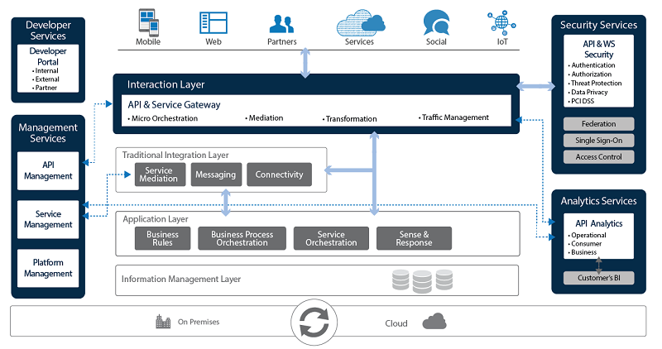
Business Question 4

Slide 9
Business Question 5
Can you recommend a secure framework for coding an API?
The secure framework for API development is Postman.
Postman is an API Client it is used to develop, test, share and document APIs.

Slide 10
Business Question 6
What data interchange format should we use while transferring data between locations?
JSON is the preferred format for transferring data between location. As it simple, secure and versatile nature, which makes it simple to read, write, and manipulate through coding. We may create our own JSON schema and make it scalable to meet the needs of the data to be processed.

Slide 11
Business Question 7
How should we store our data in our many locations?
We can store data in many locations on our local machine, cloud server, External hard drive.
This makes our data more secure and data can be accessed from anywhere.

Slide 12
Business Question 8
What are the ethical concerns related to the transmission of personal data?
Some concerns can Confidentiality and Privacy of Personal Data
Data loss
unauthorized access to private data

Slide 13
YouTube Video Link: http://youtu.be/Q7T6HVlD2NM?hd=1

Slide 14
THANK YOU !!

